Slide 1

~A web application for all your second hand products.

Slide 2
Introduction
A Web Application is the prospect that empowers web users to access applications over internet or intranet.
The simplicity and effectiveness of this systems provides great advantages to organizations.
There are about 1,722,969,600+ websites all around the world.

Slide 3
Keeping that in mind, we built our web application for easy management of second hand products,
AMAJUNA

Slide 4
Features of the system
The customer will be assigned a user id while registering
The seller will provide the system with the products description.
The product will belong to a certain category as per its title and id.
The category may be of 2 types, vehicles, and mobiles.

Slide 5
Features of the system
Electronics will have attributes like, screen size, RAM, OS, brand, product id.
Vehicles will have attributes like, seating capacity, product id
The buyer, from its account will be able to view the sellers contact info and city and what they are selling and can contact the seller directly

Slide 6
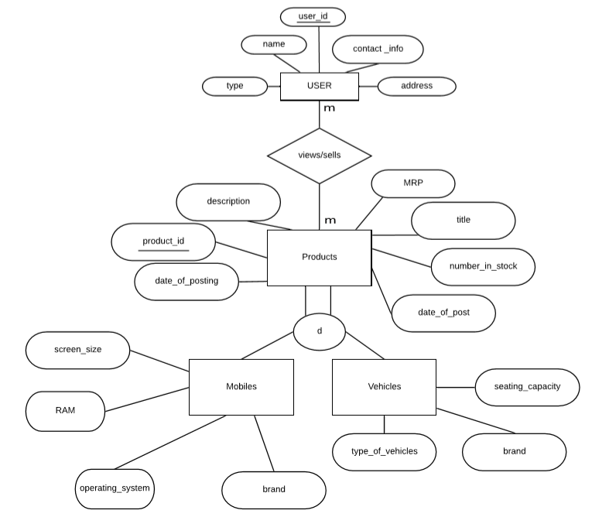
Entity Relationship diagram

Slide 7
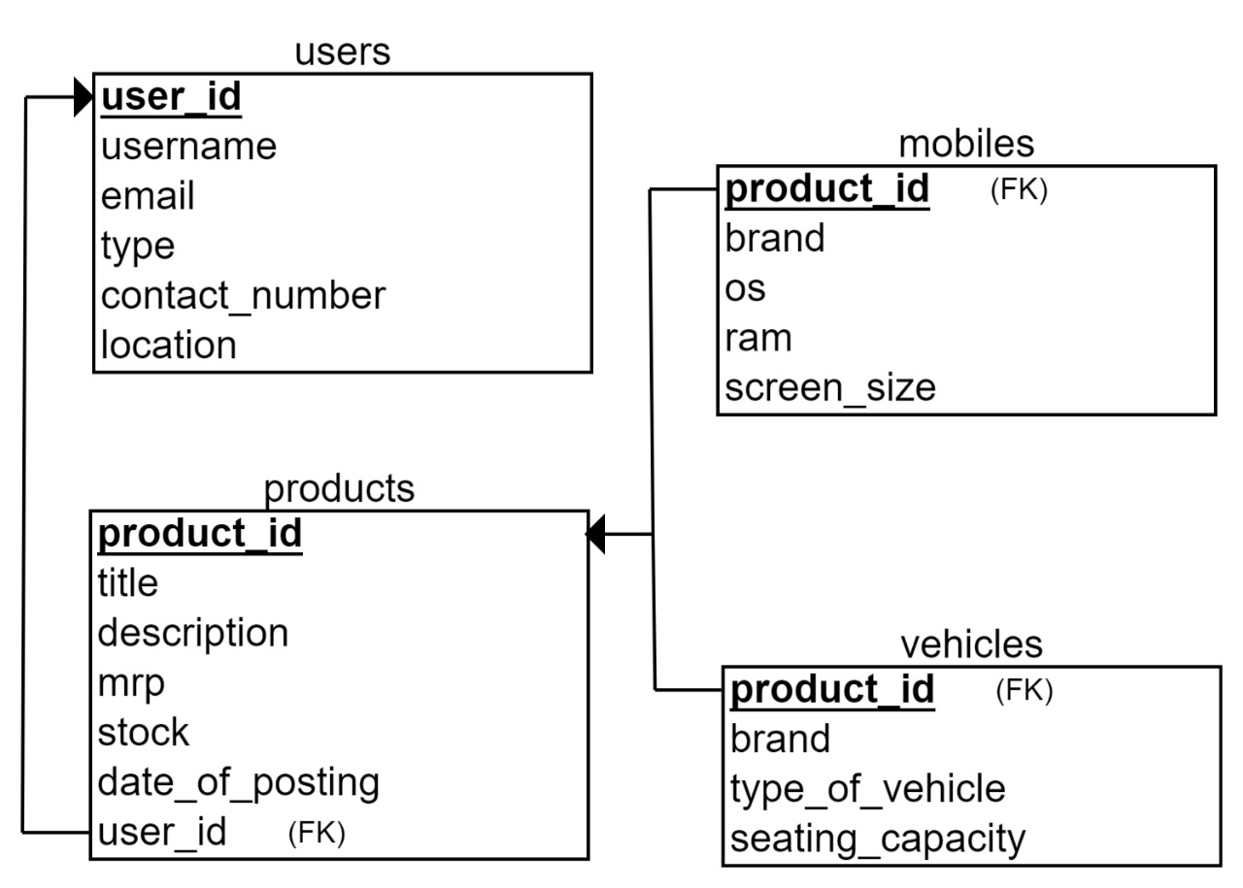
Relational diagram

Slide 8








System Requirements Specification(SRS)
UI Requirements
Database Requirements
Functional Requirements

Slide 9

UI Development tools

Slide 10


Database Development tools

Slide 11


Back End Development tools
Web Server
Operating System

Slide 12
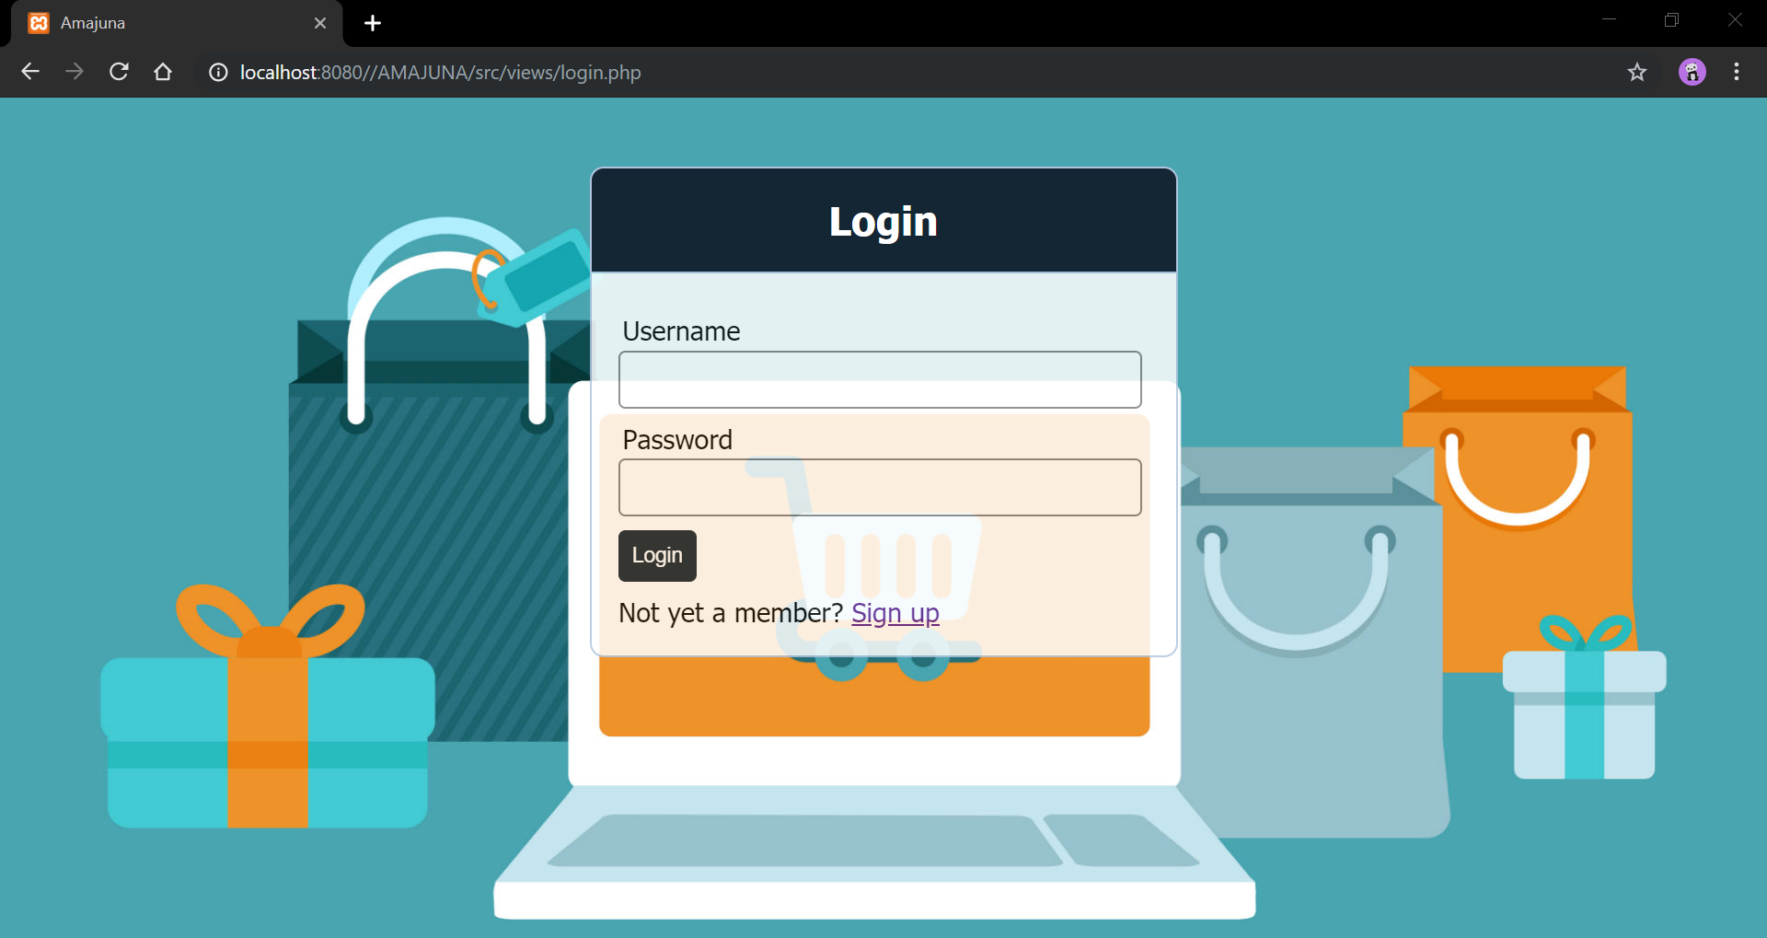
Screenshots of the application
Login

Slide 13
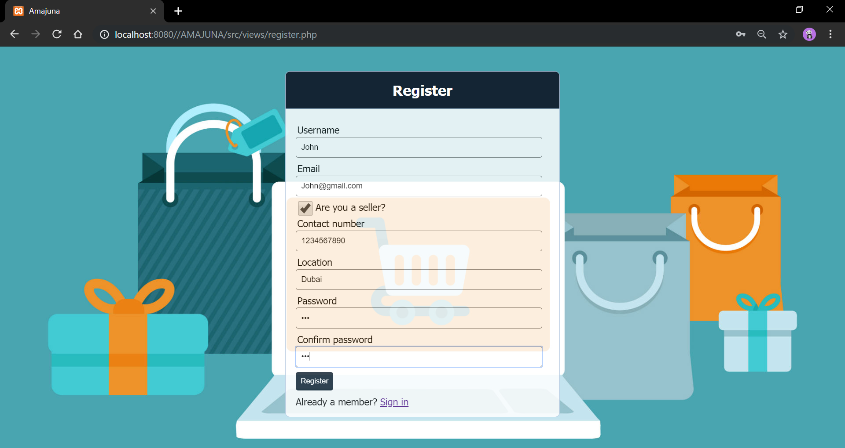
2. Registration

Slide 14
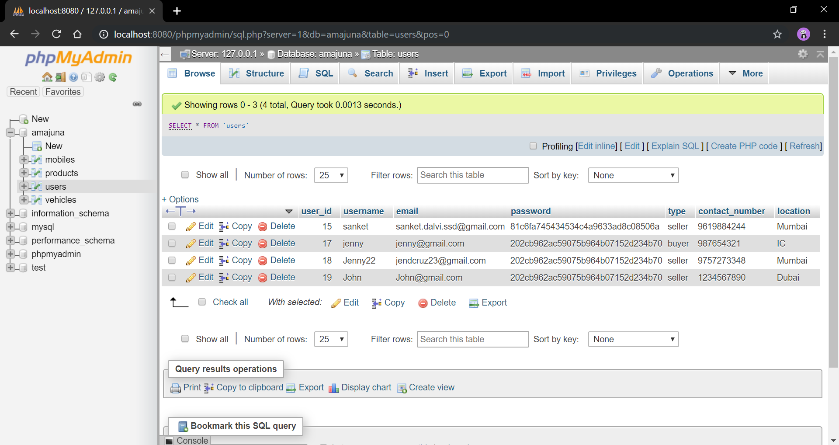
3. User data being saved in the database

Slide 15
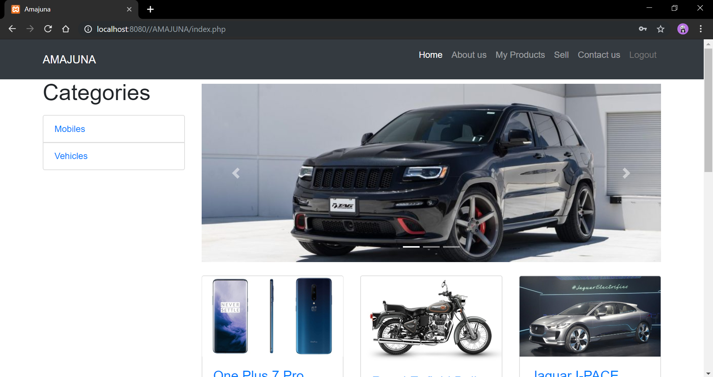
4. Home page for the seller

Slide 16
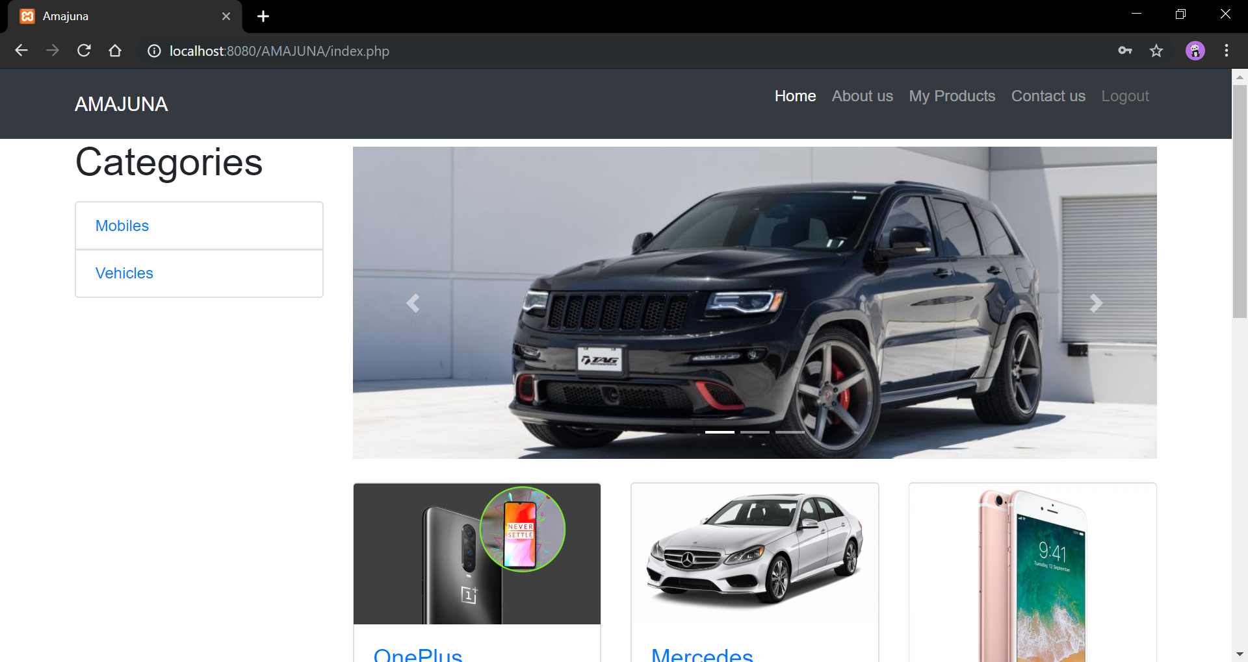
5. Home page for the buyer

Slide 17
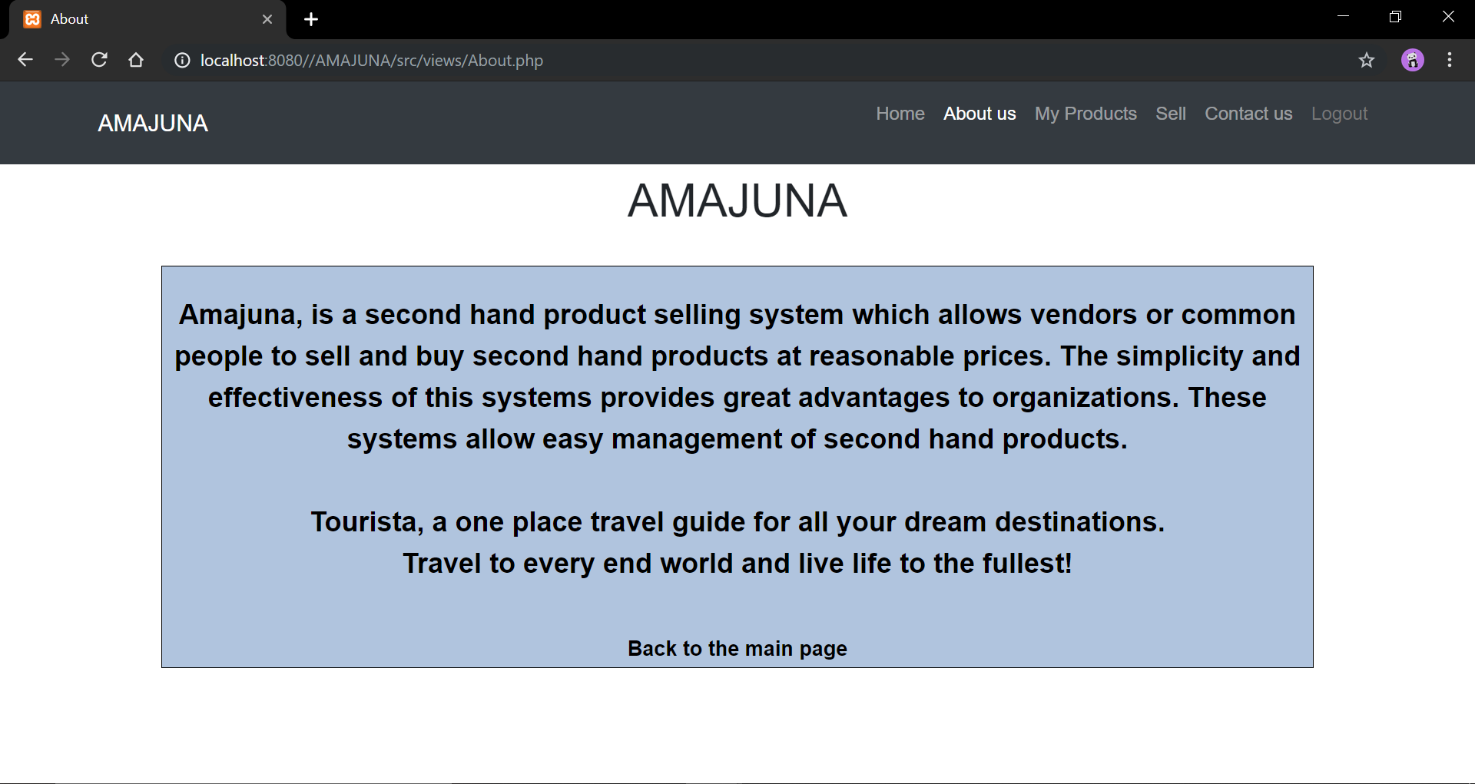
6. About the web application

Slide 18
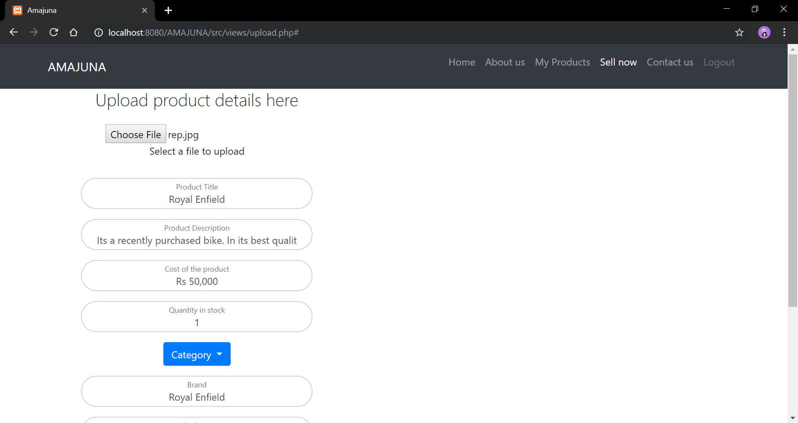
7. Uploading a product

Slide 19
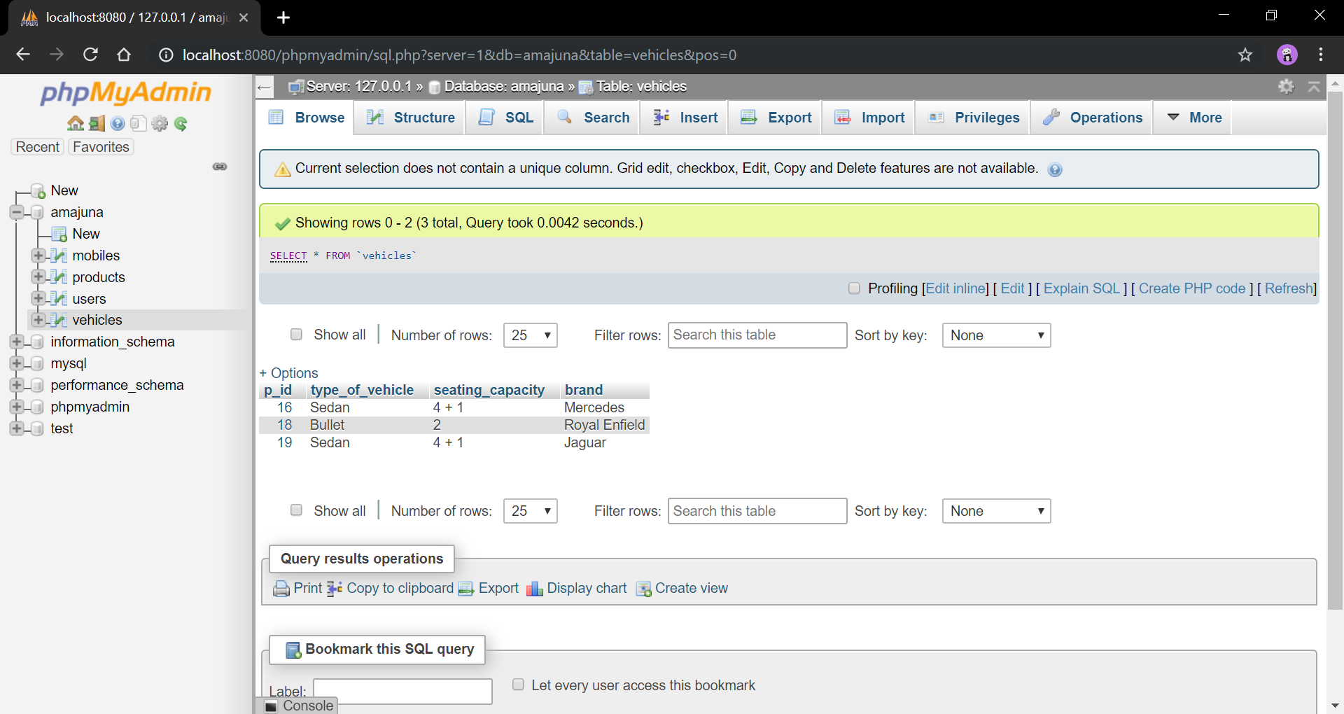
8. Product details are stored in the database

Slide 20
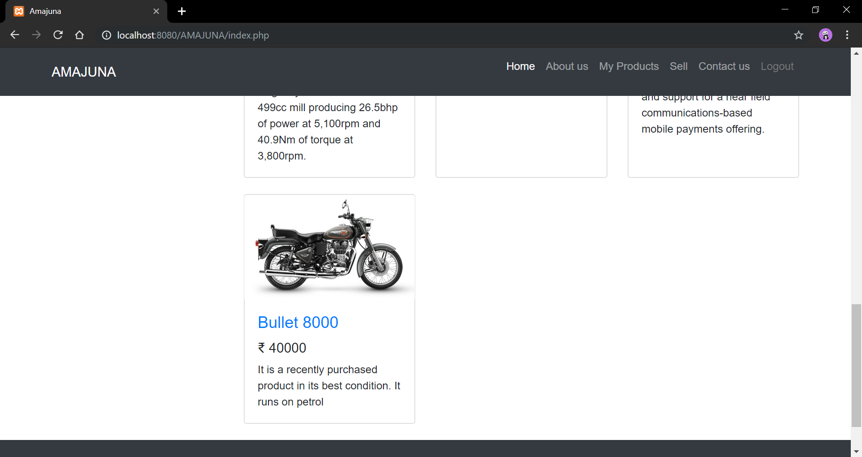
9. Product display on the sellers side

Slide 21
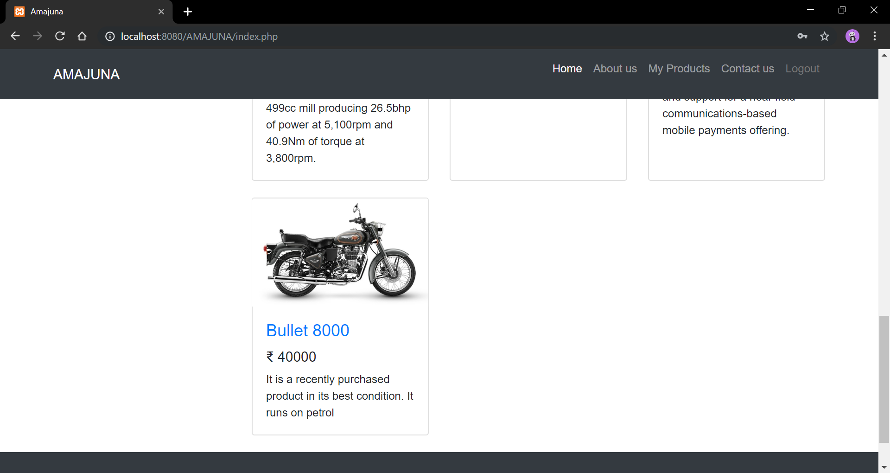
10. Products display on the buyers side

Slide 22
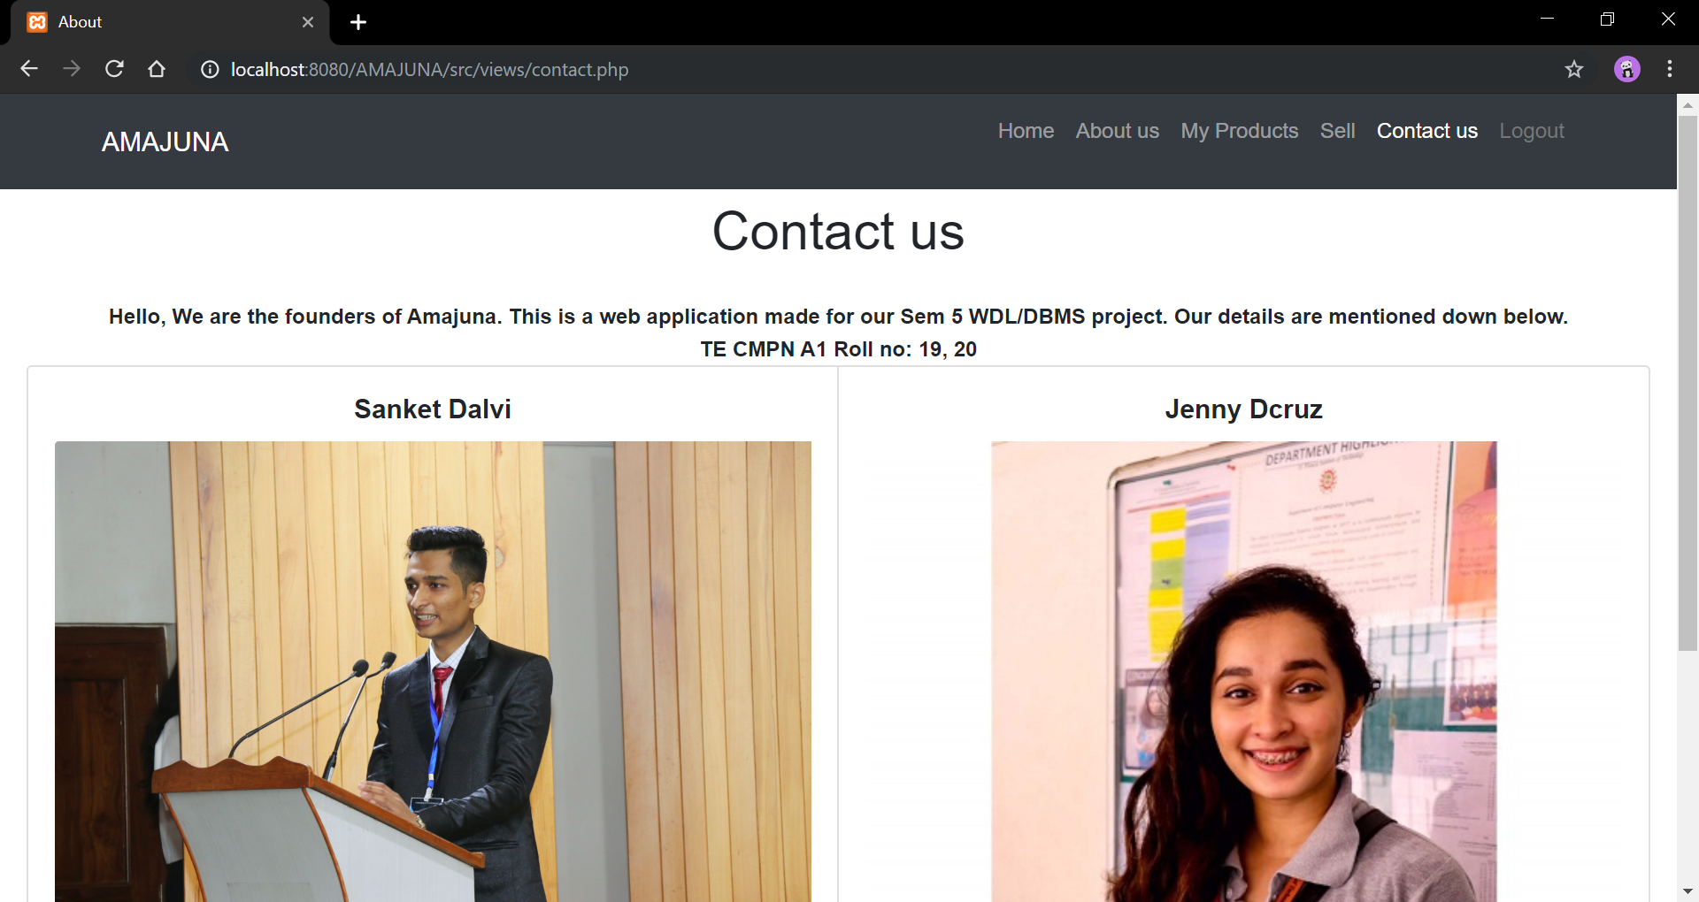
11. Contact us

Slide 23

12. On logging out

Slide 24
Acknowledgements
This web application is made by,
19 - Mr. Sanket Dalvi
20 - Ms. Jenny Dcruz
Under the guidance of Ms. Pratibha Rane and Ms. Safa Hamdare for Semester 5, academic year 2019-20.

